Slide 1
Recurrent Neural Network (RNN)

Slide 2
RnN
Recurrent Neural Networks (RNNs) are a type of artificial neural network designed to recognize patterns in sequences of data, such as text, genomes, handwriting, or the spoken word.
Sequence data is temporal and ordered, making it different from other forms of data.
RNNs are particularly useful for this type of data because they can store past information

Slide 3
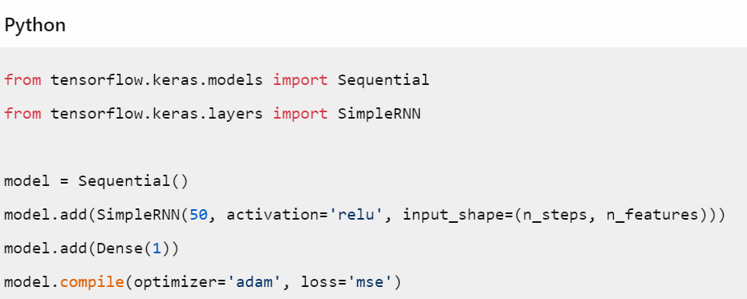
TensorFlow and Keras
TensorFlow is a powerful open-source software library for machine learning
Keras is a high-level neural networks API, written in Python and capable of running on top of TensorFlow

Slide 4
LSTM and GRU Networks
LSTM (Long Short-Term Memory) and GRU (Gated Recurrent Unit) are types of RNNs that can capture long-term dependencies.
The key difference between LSTM and GRU is that LSTM has an extra gate known as the forget gate, while the GRU does not

Slide 5
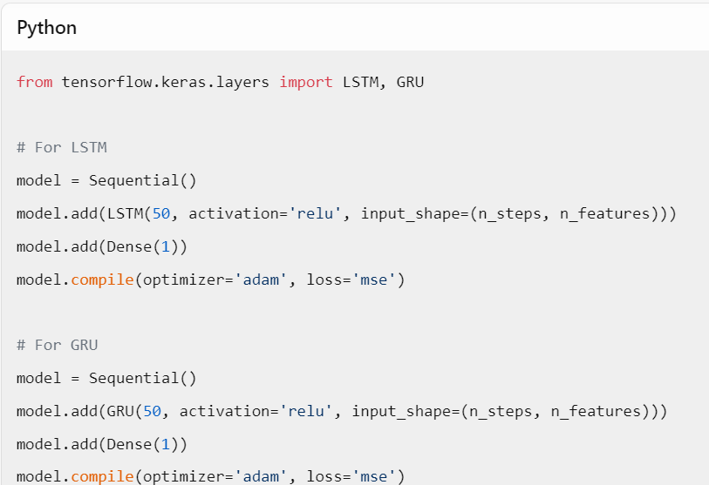
Training LSTM and GRU Networks

Slide 6
Comparison
Features | LSTM | GRU
Memory Cell | Yes | No
Gates | Input, Forget, Output | Reset, Update
Ability to Capture | Strong | Moderate
Computational Efficiency | Moderate | High
Parameters | More | Fewer
Complexity | Higher | Lower
Gradient Vanishing Problem | Addressed | Addressed
Control of Information Flow | More precise | Less precise
Implementation Variants | LSTM, LSTM variants | GRU, GRU variants

Slide 7
Conclusion

Slide 8
THANK YOU
Abdullah Azher Chaudhary
+92-327-4534352​
abdullahazher11@gmail.com
https://linktr.ee/abdullahazherchaudhary

